Slide 1






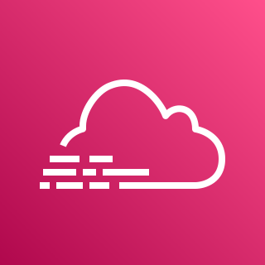
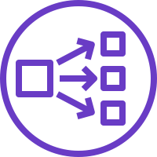



Production System
AWS Cloud
Availability Zone 1
Availability Zone 2
Availability Zone 3
VPC
Public subnet
Public subnet
Auto Scaling group
Amazon CloudWatch
Bastion host
Private subnet
Network Load Balancer
Private subnet
Private subnet
AWS CloudTrail
Security group
Security group
IRIS mirror node 1
IRIS mirror node 2
Arbiter
Amazon S3
Mirror data traffic
Mirror health check

Slide 2

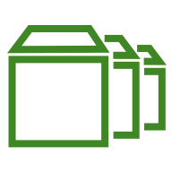
Demo/Test System
AWS Cloud
Availability Zone
VPC
Public subnet
Security group
IRIS instance with Amazon EBS volumes

Slide 3



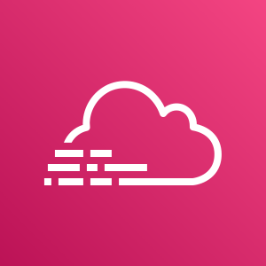

Production System
AWS Cloud
Availability Zone A
Availability Zone b
Availability Zone C
VPC
Subnet
Subnet
Subnet
Network Load Balancer
Security group
Security group
Internet gateway
IRIS Mirror Node 1
IRIS Mirror Node 2
Arbiter
10.0.1.0/24
10.0.2.0/24
10.0.3.0/24
10.0.0.0/16
S3 Bucket
AWS CloudTrail
Amazon CloudWatch
Mirror data traffic
Mirror health check

